Slide 1
205, Nov 8, Class 19
Statistics 3:
  Correlation
  X²
Final Project updates

Slide 2
Wason Card Task
A
D
4
7
Hypothesis: If a card has a vowel on one side, then it has an even number on the other side.
Which cards do you turn over?

Slide 3
The Bar Bouncer task
Soda
Beer
16
22
Hypothesis: If a person is drinking beer, they must be 21 years or older…
Which cards do you turn over?

Slide 4
Correlation example
How does watching TV affect vocabulary size?
Survey
  How many hours of TV do you watch each week?
  Measure of vocabulary size
    Verbal SAT or similar

Slide 5
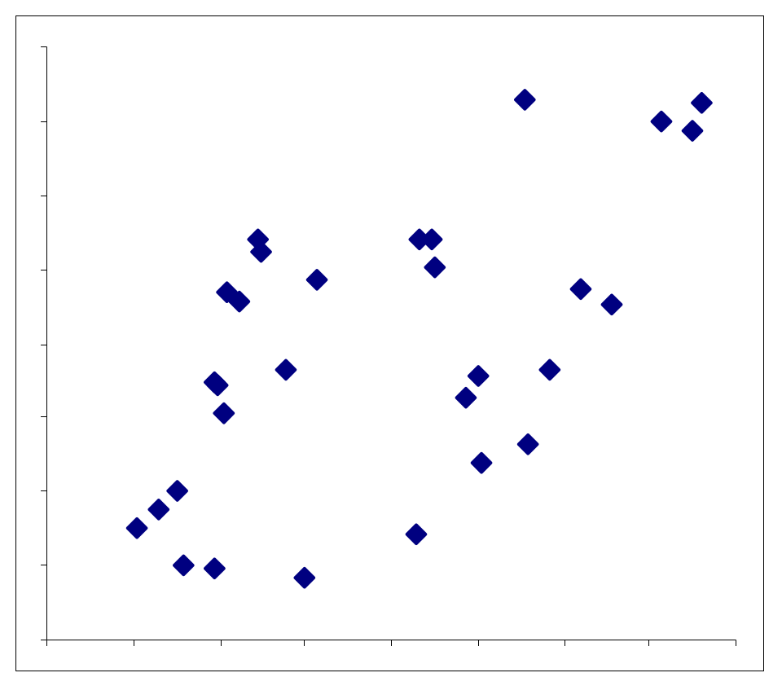
A significant positive correlation was found between hours of TV viewing and vocabulary, r = 0.62
Hours of TV/week
Vocabulary size

Slide 6
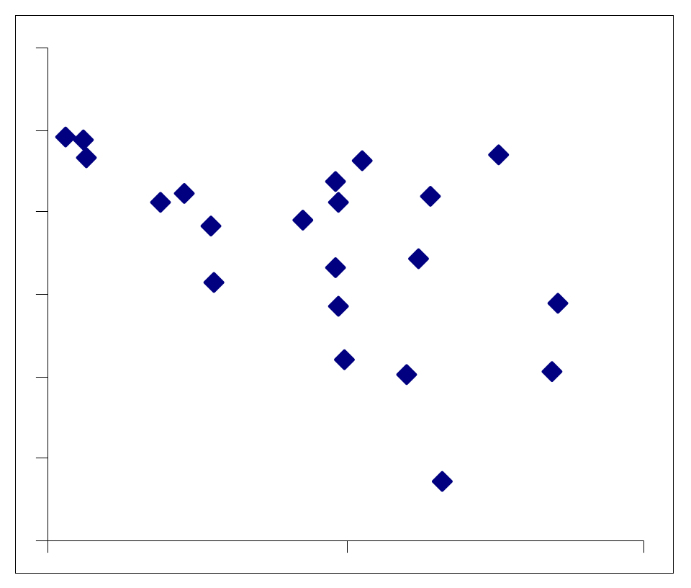
A significant negative correlation was found between hours of TV viewing and vocabulary, r = -0.54
Hours of TV/week
Vocabulary size

Slide 7
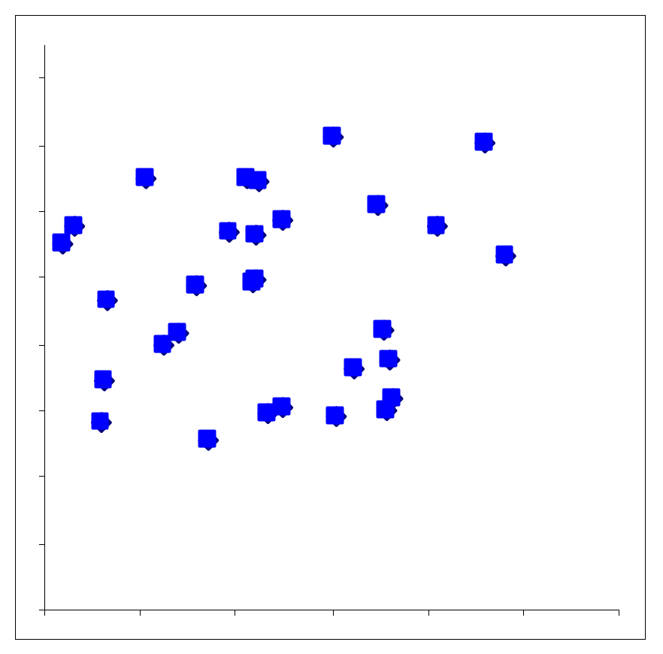
No correlation was found between hours of TV viewing and vocabulary,
r = .08.
Hours of TV/week
Vocabulary size

Slide 8
Correlation analysis
Measure of association between two continuous variables
  Range -1.0 to 1.0
    Null hypothesis is zero
Most frequently done in non-experimental research
  Correlation does not imply causation
    But also does not guarantee not being causal
  Alternate hypotheses: Y -> X, Z -> (X, Y)

Slide 9
Related analyses
Spearman’s rank correlation
  For unusual distributions
Regression
  General linear modeling (GLM)
  Percentage of variance accounted for: r²
  ANCOVA
Multivariate techniques
  Correlation matrices
  Factor analysis
  Structural equation modeling

Slide 10
Mum effect
A “lost postcard” technique was employed to examine attitudes towards informing people of their romantic partner’s apparent infidelity. Stamped and addressed postcards were left on the windshields of 180 cars parked near mailboxes, with an accompanying handwritten note reading “Found this by your car – is it yours?”
One-third (60) of the cards had a neutral/good news (control) message, “Glad to hear you’ve working things out. We’re getting along better too. Keep in touch.” Thirty of these were addressed to a male, 30 to a female.
The other 120 cards, equally divided by gender, informed the addressee of his (her) girlfriend’s (boyfriend’s) apparent infidelity, in the following message: “Dear Bob [Judy], I hate to be the one to tell you this, but I think I saw you girlfriend Ann [boyfriend Bob] coming out of the Travelodge off El Cajon Blvd with another guy (woman) on Thursday. It might not be important, but I didn’t know how to tell you in person – Barry [Beth]”
  35 good news postcards were returned
  23 bad news postcards were returned:
  19 to addressed to Bob, 4 to Judy

Slide 11
Chi²
Doing a Chi² Analysis:
  Step 1: Contingency table
    Calculate rates
  Step 2: Test hypotheses
    Do the rates differ across conditions?

Slide 12
Contingency Table with Rates
 | Returned | Not returned | Total
Good news | 35 (.583) | 25 (.417) | 60
Bad news | 23 (.192) | 97 (.808) | 120
Total | 58 (.322) | 122 (.678) | 180

Slide 13
If Good news=Bad news, then expected return rate for both good news and bad news should be the same
  .322 (58/180)
  19.3 for Good news (of 60)
  38.6 for Bad news (of 120)
Х² is calculated from the difference between the observed rates and the expected rates.
Actual return rates are much different, Х²=28.1, p<0.001
“Postcards reporting good news were returned at a higher rate than postcards reporting bad news, X²=28.1, p<.001.”

Slide 14
Was there a difference in the rate of “bad news” cards being returned addressed to men (Bob) or women (Judy)?
 | Returned | Not returned | Totals
Men | 19 (.317) | 41 (.683) | 60
Women | 4 (.067) | 56 (.933) | 60
Total | 23 (.192) | 97 (.808) | 120

Slide 15
Final Projects
Post proposal outline to Group page on Canvas
  Describe your 2x2 design
  Be clear which is your manipulated factor
  Describe the method you plan to use to collect your DV

Slide 16
For Monday 11/11
Chapter 17
  Qualitative research

